Slide 1
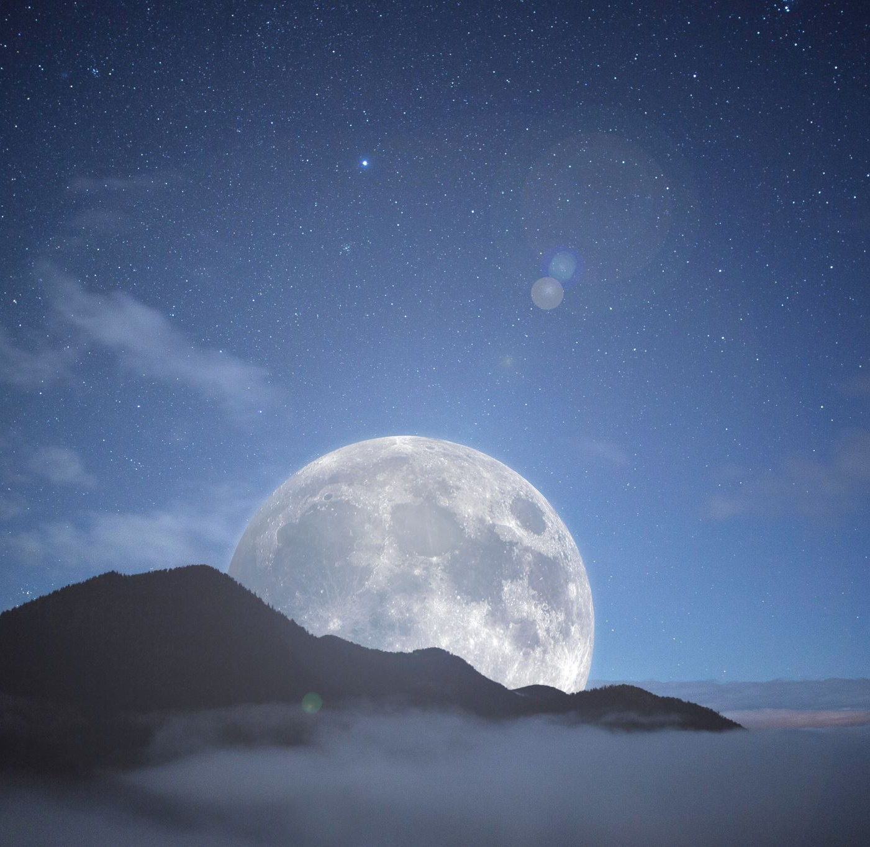
Astronomy 100/1 Lab Moon Photo Project
[subtitles]

Slide 2
Extra credit: The Curious Incident of the Moon in the Day-time
Take two photos of the Moon during the daytime.
Take one photo of the Moon with the camera zoomed all the way OUT (1x).
Include the horizon or some other object level with you. This can be done with your camera vertical (i.e. portrait mode).
Take another photo of the Moon with the camera zoomed all the way IN.
When you turn in the project, you will also need to get a Stellarium screenshot of the Moon from the same time and place, so make sure you record those.

Slide 3
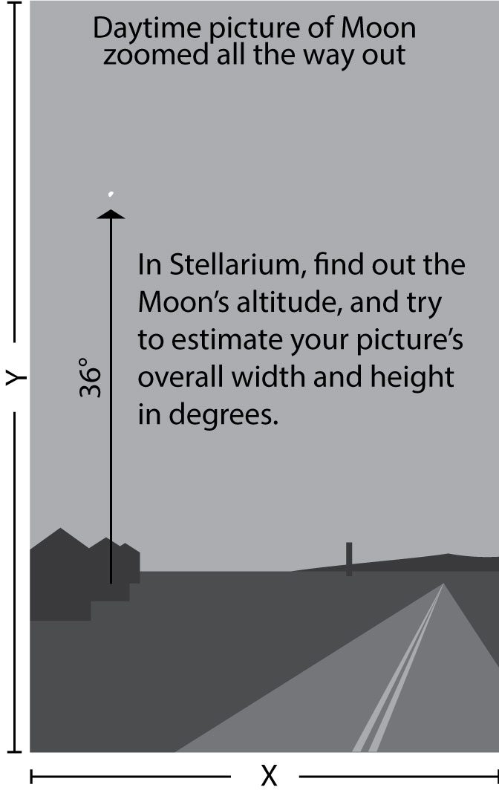
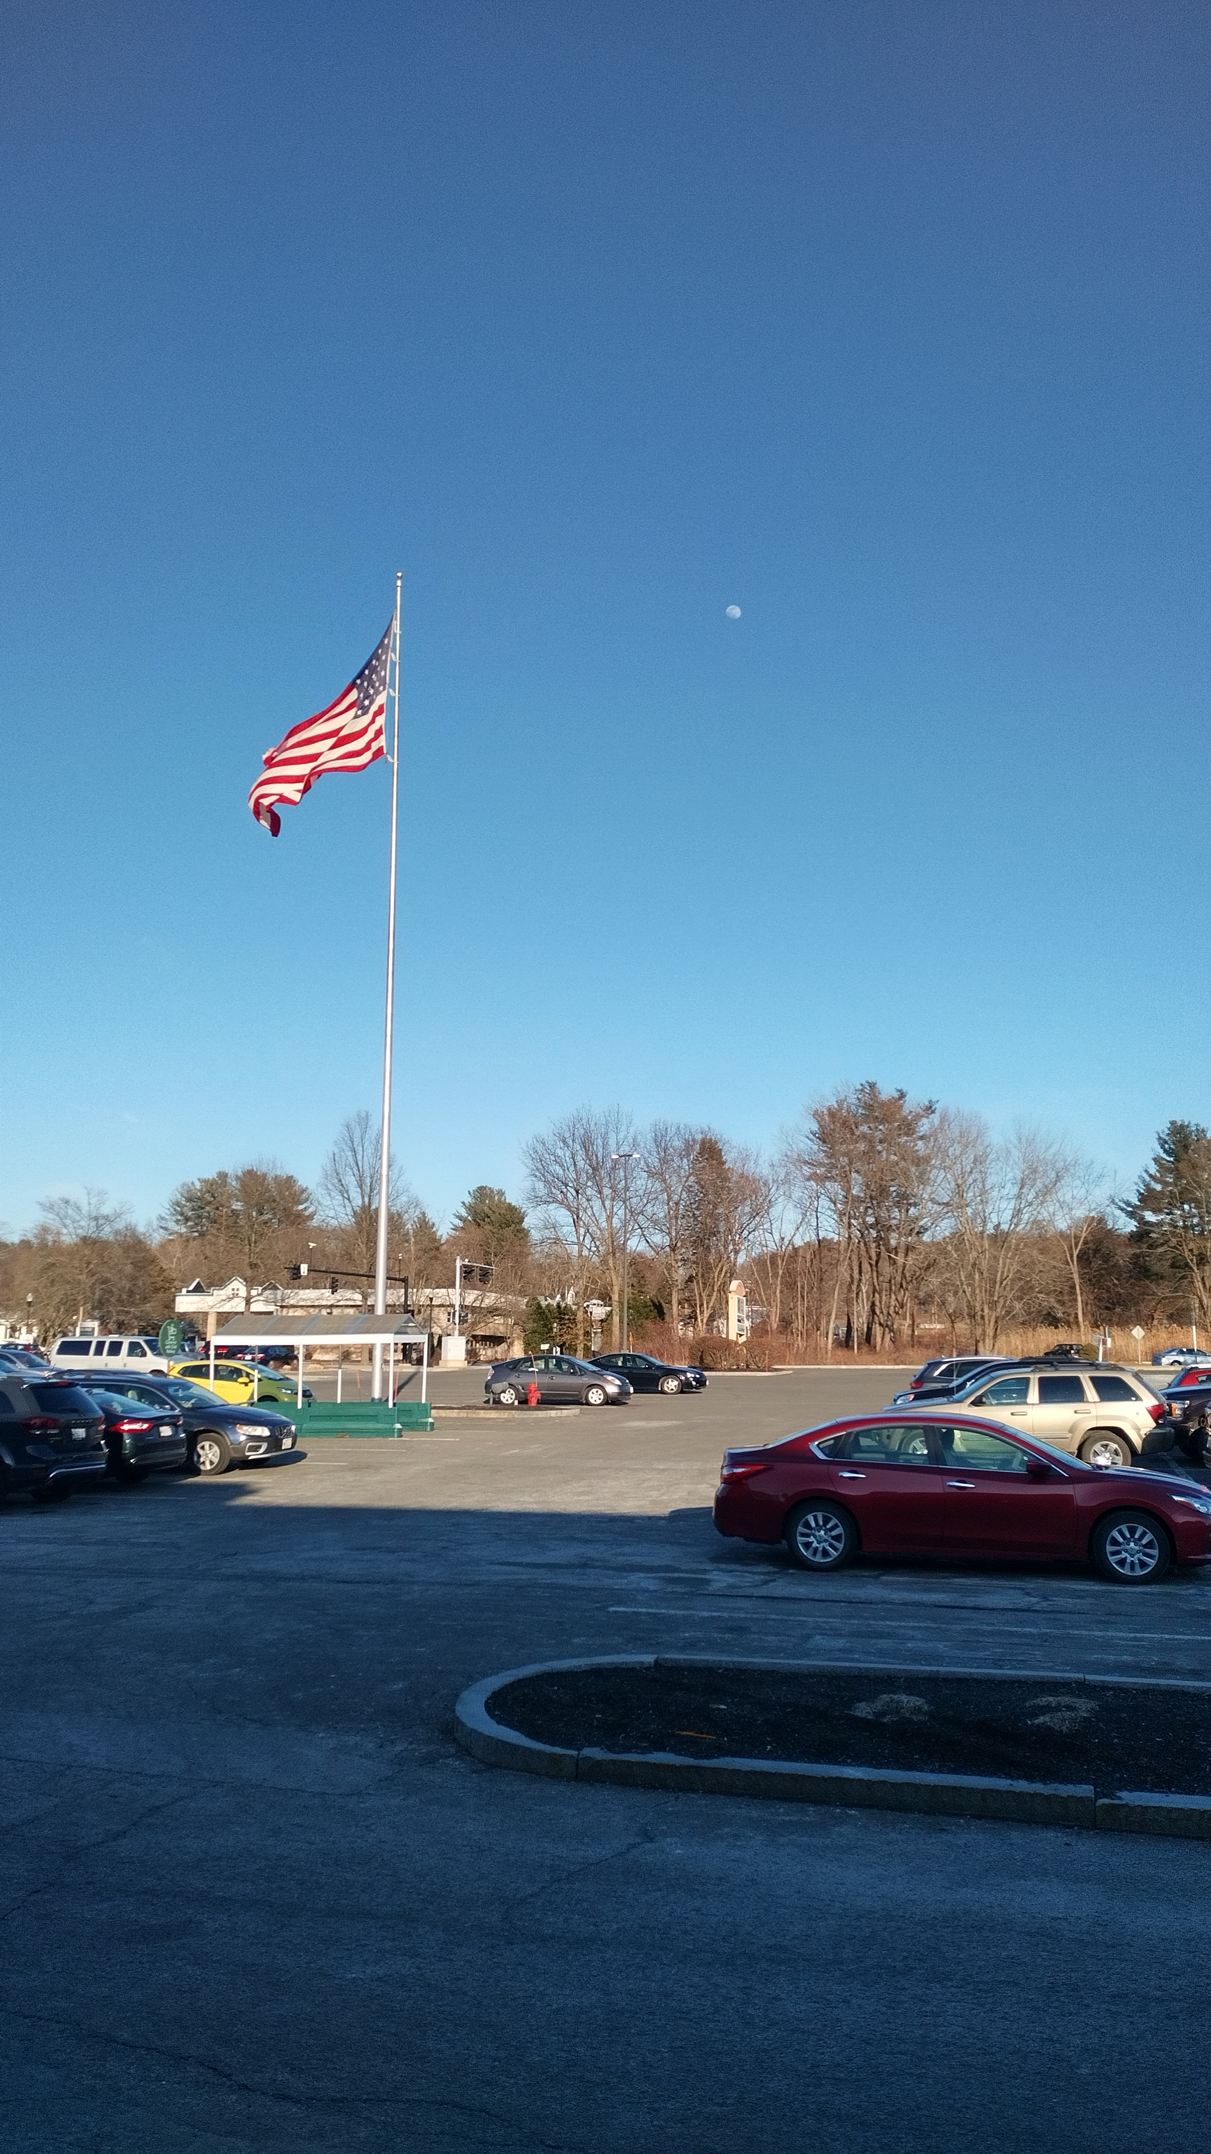
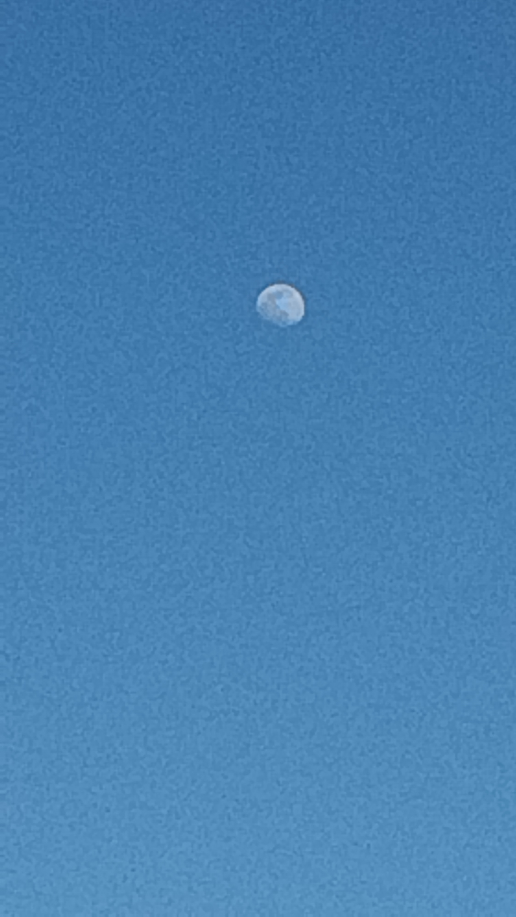
Yvonne Ban
Amherst, MA
14 Mar 2022
Yvonne Ban
Amherst, MA
14 Mar 2022

